Slide 1
Backend Isolation with OpenTelemetry Collector

Slide 2

ALEJANDRO ARBOLEDA
Electronical Engineer
AWS DevOps Engineer
5x AWS Certified
3X Linux Foundation Certified (LFCS, CKA, CKAD)
Hashicorp Terraform Certified
Python Developer

Slide 3
AGENDA
01
Telemetry Signals
02
Observability
03
Before OpenTelemetry
04
OpenTelemetry and OTel Collector
05
Use Case
06
Demo

Slide 4



Telemetry Signals
Logs
Metrics
Traces
Registry with individual events of one instance of a system.
What & when happened?
Quantitative measure to evaluate the health or performance of a system.
How much?
Sequence of events and interactions between components.
How, why and what happened?

Slide 5
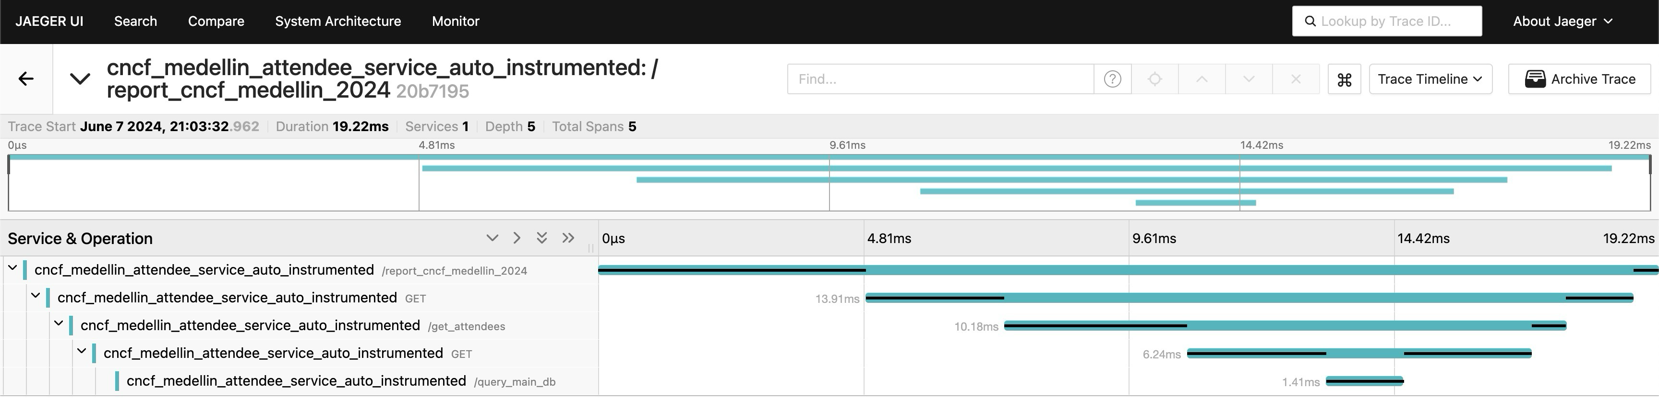
Distributed Tracing
Shows how a transaction (request) is processed end to end

Slide 6
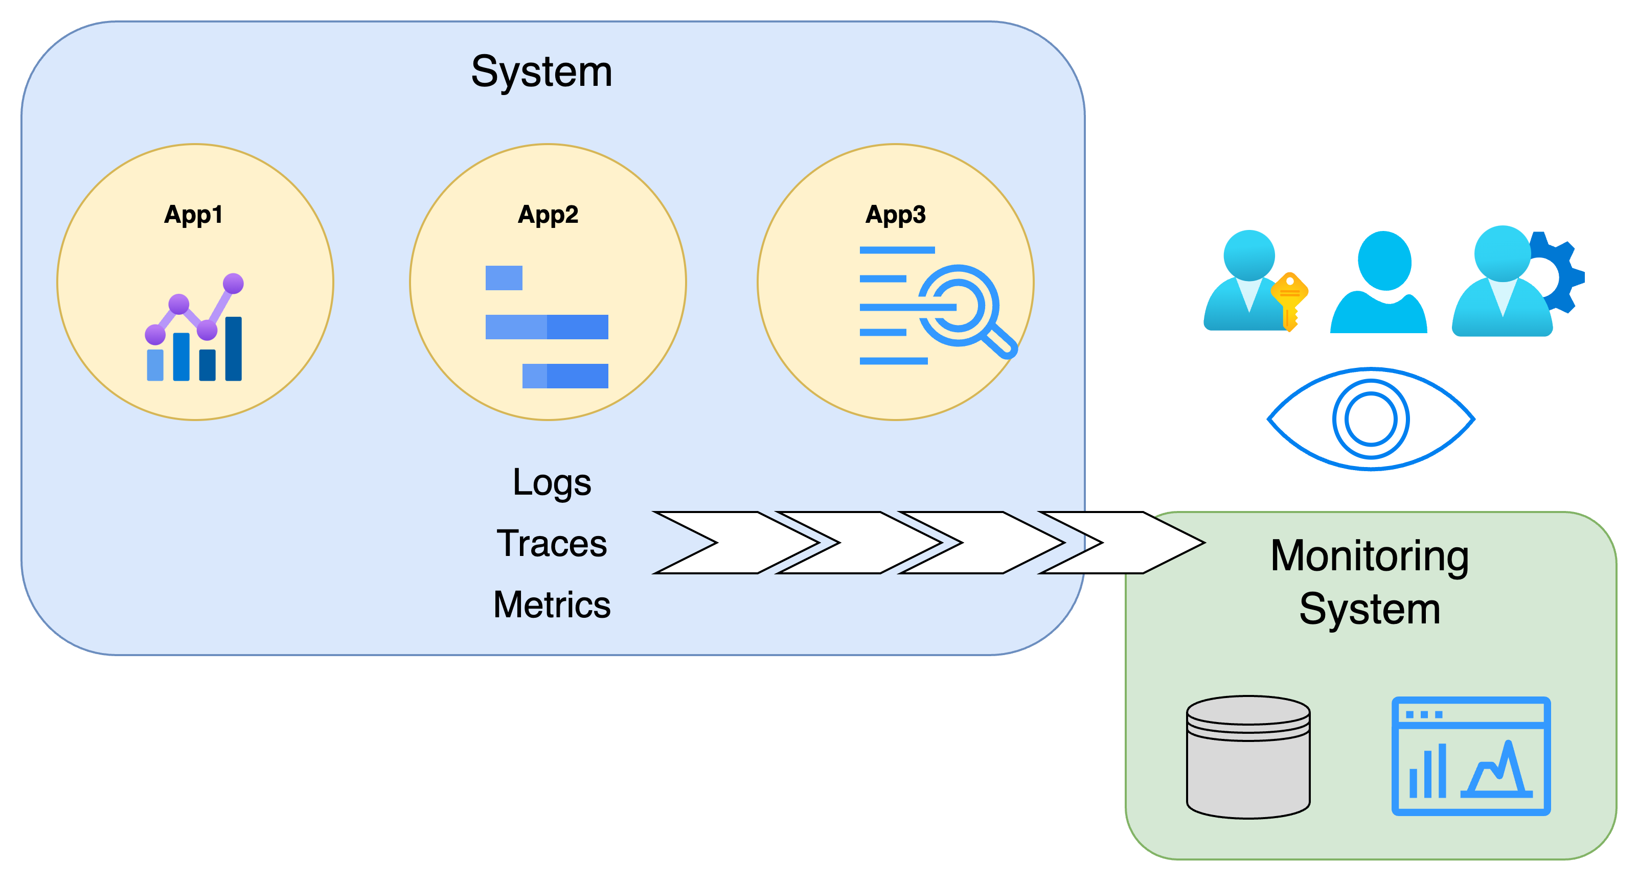

OBSERVABILITY
1. Ability of a system for anybody to infer its internal state based on its logs, metrics, and traces. (Control Theory)
2. Getting information about the state of a (distributed) system --without shipping new code-- by observing its outputs: Traces, Logs, Metrics (Software engineering)

Slide 7
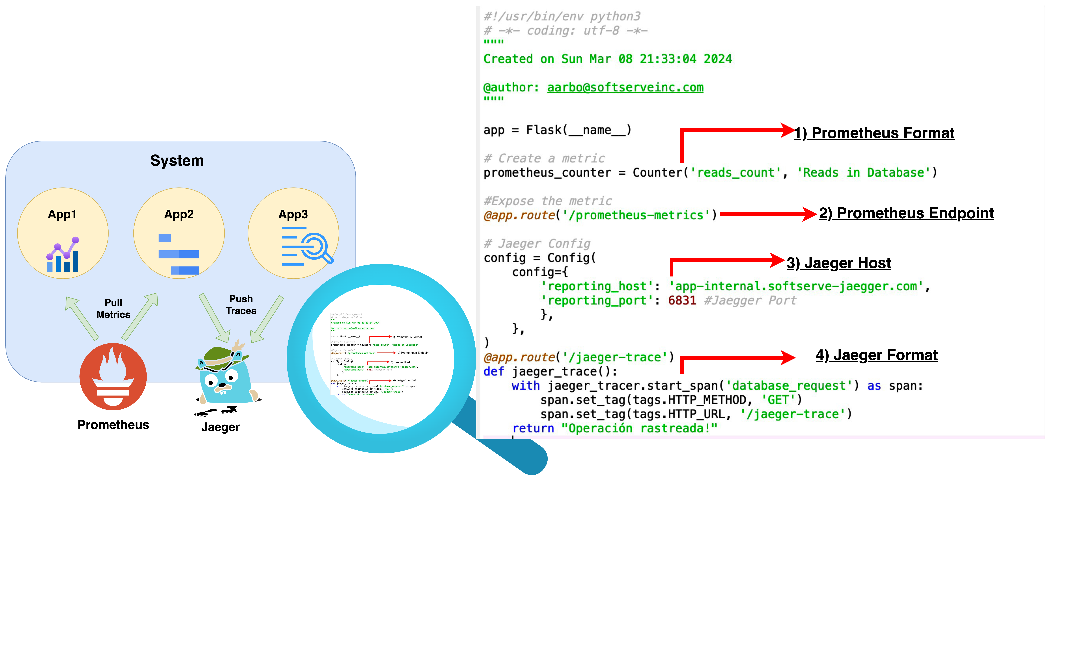
How was observability Before open telemetry?

Slide 8



OpenTelemetry
Collection of APIs, SDKs, and tools to instrument, generate, collect, and export telemetry data
Specification
Implementation
Backend Isolation
Bunch of readme files specifying how to develop for OpenTelemetry
SDK: Several languages support to create and send Telemetry signals and autoinstrument applications
Otel Collector: Receiver, processor and exporter

Slide 9
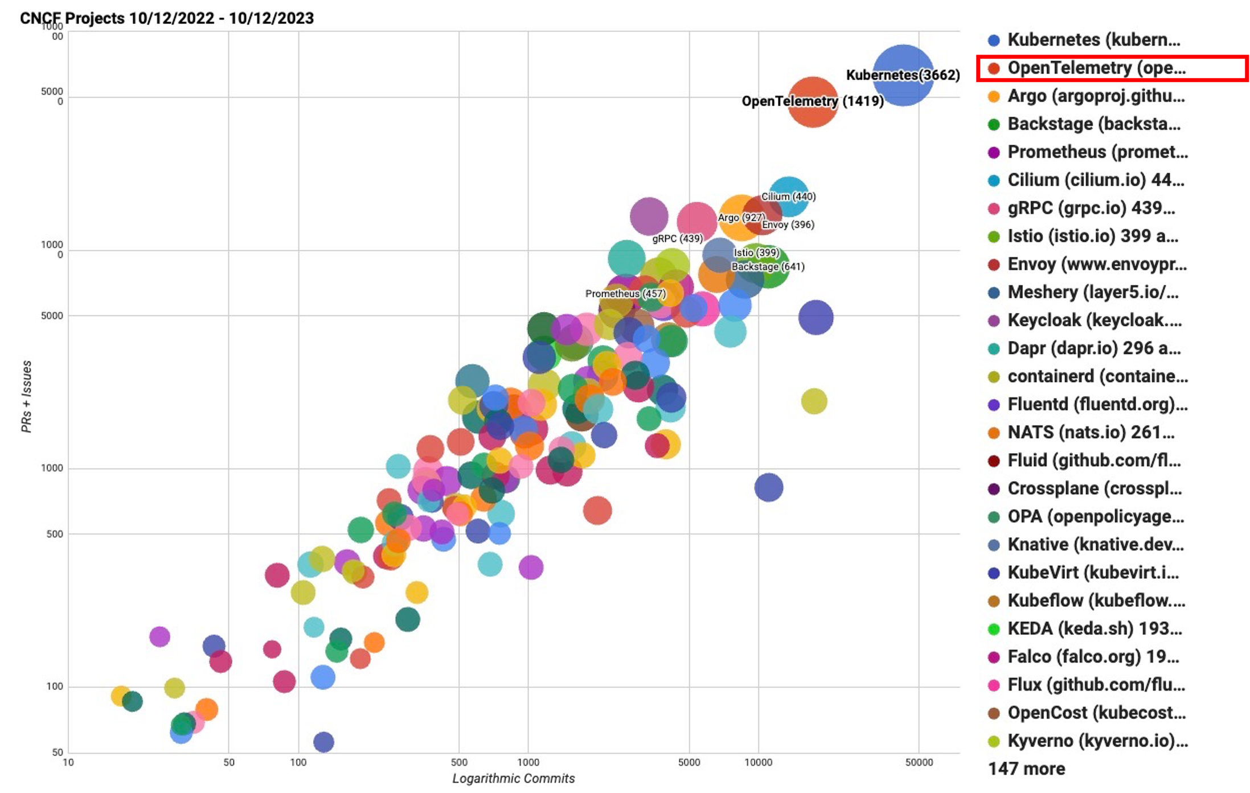
Open Telemetry: Extra motivation
Velocity of CNCF projects
OpenTelemetry Top Contributors
Rank | Companies
1 | Splunk Inc.
2 | Microsoft Corporation
3 | LightStep Inc.
4 | Dynatrace LLC
5 | Google LLC
6 | Amazon
7 | New Relic Inc.
8 | Hound Technology
9 | observIQ
10 | Cisco
Reference
Reference

Slide 10
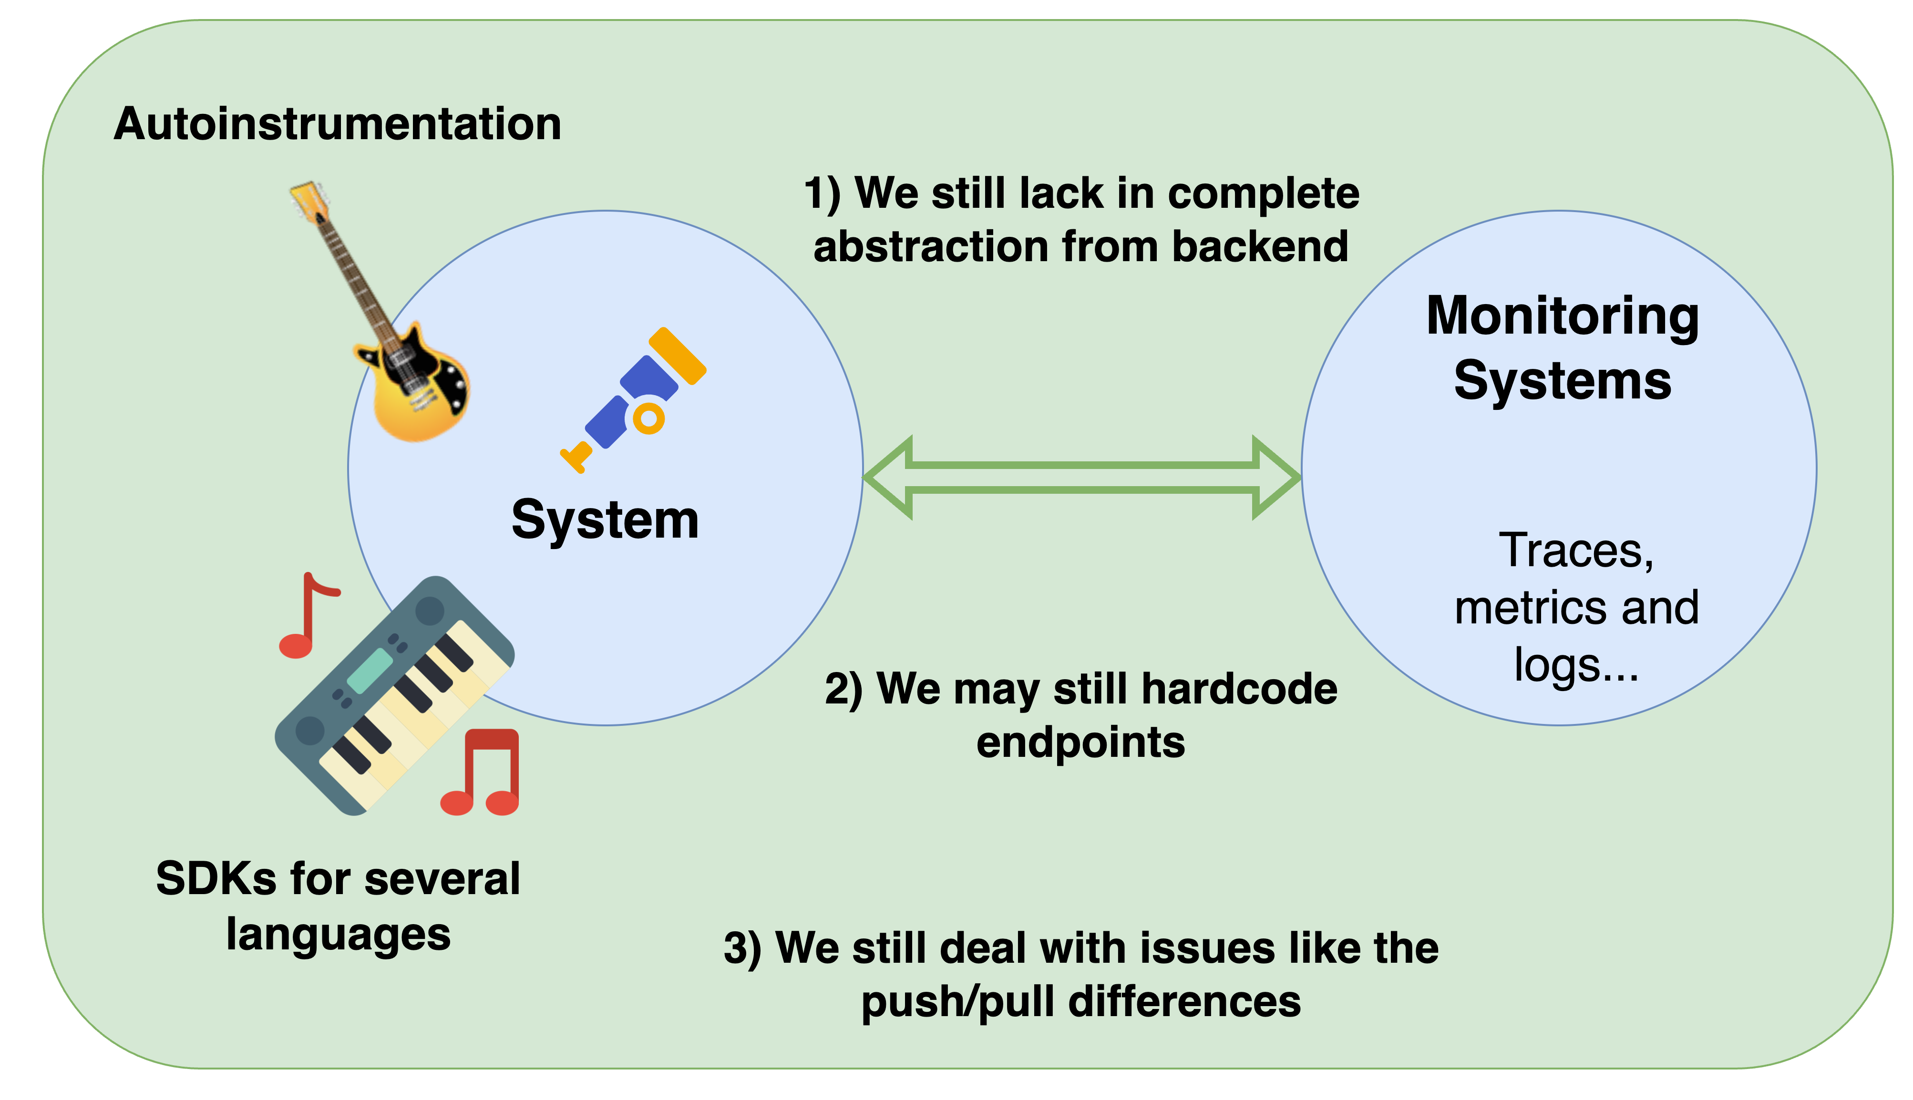
OpenTelemetry first architecture

Slide 11
OTel Collector
Highly configurable and highly scalable feature to ingest, process and export telemetry data
Application 1
Application 2
OTel Collector
OTel Collector
Otel Backend
Vendor OpenSource Database

Slide 12
Otel Collector Pipeline
Traces Pipeline
Receiver
Processor
Exporter
Metrics Pipeline
Receiver
Processor
Exporter
Logs Pipeline
Receiver
Processor
Exporter

Slide 13
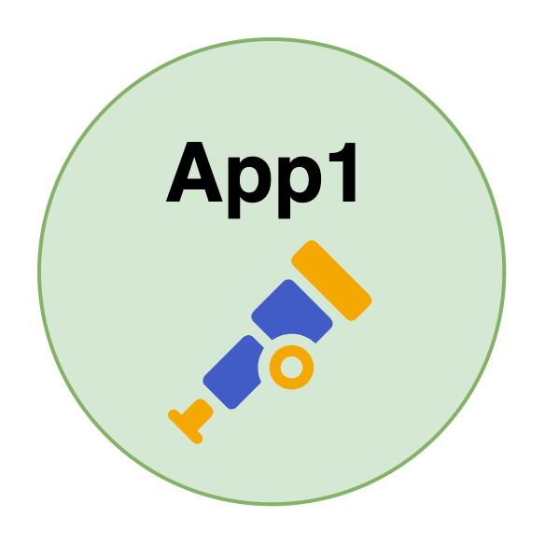
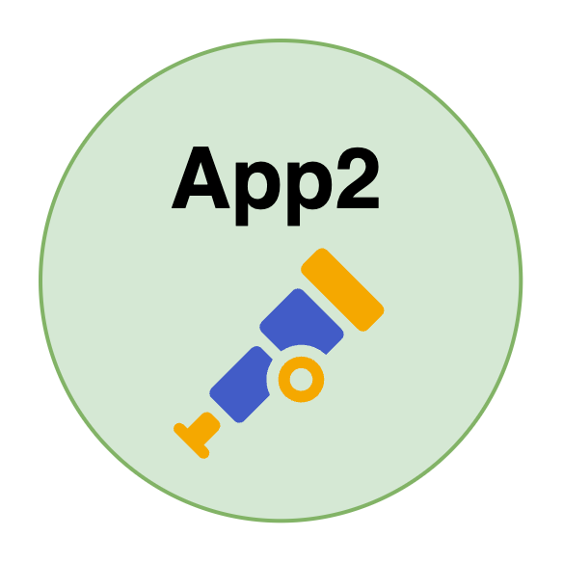




USE case: Migration with otel collector
What if Stakeholders make the decision to
decommission Prometheus and Jaeger?
Traces
Metrics
Traces
Metrics
Migration required?
Otel Collector
Otel Collector
No! we have OTel Collector
Metrics
Traces
Metrics
Traces
Backend isolation!!!
Prometheus
Jaeger
Statsd
Zipkin

Slide 14
DEMO
Traces System Migration

Slide 15
THANK YOU!
ALEJANDRO ARBOLEDA
Email: alejandro.arboleda.quiroz@gmail.com
Linkedin: https://www.linkedin.com/in/alejandro-arboleda-quiroz
Demo code: https://github.com/arboleda-alejandro/talks

